Slide 1

APBD – lecture 13
Blazor – Authentication/Authorization

Slide 2
ASP.NET Core Identity
ASP.NET Core Identity:
Is an API that supports user interface (UI) login functionality.
Manages users, passwords, profile data, roles, claims, tokens, email confirmation, and more.

Slide 3
ASP.NET Core Identity
Users can create an account with the login information stored in Identity or they can use an external login provider. Supported external login providers include Facebook, Google, Microsoft Account, and Twitter.
Identity is typically configured using a SQL Server database to store user names, passwords, and profile data. Alternatively, another persistent store can be used, for example, Azure Table Storage.

Slide 4
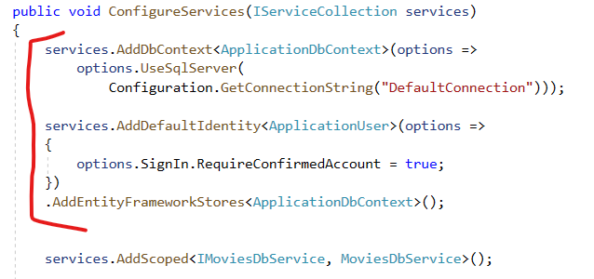
ASP.NET Core Identity - Server app configuration
Startup class
Startup.ConfigureServices
ASP.NET Core Identity

Slide 5
ApplicationDbContext
In the ApplicationDbContext (Data/ApplicationDbContext.cs), DbContext extends ApiAuthorizationDbContext<TUser> to include the schema for IdentityServer.
ApiAuthorizationDbContext<TUser> is derived from IdentityDbContext. To gain full control of the database schema, inherit from one of the available Identity DbContext classes and configure the context to include the Identity schema by calling builder.ConfigurePersistedGrantConte

Slide 6

ASP.NET Core Identity - Server app configuration
Startup class
Startup.ConfigureServices
IdentityServer with an additional AddApiAuthorization helper method that sets up default ASP.NET Core conventions on top of IdentityServer:

Slide 7
AddApiAuthorization
The AddApiAuthorization helper method configures IdentityServer for ASP.NET Core scenarios.
IdentityServer is a powerful and extensible framework for handling app security concerns. IdentityServer exposes unnecessary complexity for the most common scenarios.
Consequently, a set of conventions and configuration options is provided that we consider a good starting point. Once your authentication needs change, the full power of IdentityServer is available to customize authentication to suit an app's requirements.

Slide 8

ASP.NET Core Identity - Server app configuration
Startup class
Startup.ConfigureServices
Authentication with an additional AddIdentityServerJwt helper method that configures the app to validate JWT tokens produced by IdentityServer:

Slide 9
AddIdentityServerJwt
The AddIdentityServerJwt helper method configures a policy scheme for the app as the default authentication handler. The policy is configured to allow Identity to handle all requests routed to any subpath in the Identity URL space /Identity.

Slide 10

ASP.NET Core Identity - Server app configuration
Startup class
Startup.Configure
The IdentityServer middleware exposes the OpenID Connect (OIDC) endpoints:

Slide 11
ASP.NET Core Identity - Server app configuration
Startup class
Startup.Configure
The Authentication middleware is responsible for validating request credentials and setting the user on the request context:

Slide 12
ASP.NET Core Identity - Server app configuration
Startup class
Startup.Configure
Authorization Middleware enables authorization capabilities:

Slide 13
OidcConfigurationController
In the OidcConfigurationController (Controllers/OidcConfigurationController.cs), the client endpoint is provisioned to serve OIDC parameters.

Slide 14
OpenID Connect
If you’ve used your Google to sign in to applications like YouTube, or Facebook to log into an online shopping cart, then you’re familiar with this authentication option.
OpenID Connect is an open standard that organizations use to authenticate users. IdPs use this so that users can sign in to the IdP, and then access other websites and apps without having to log in or share their sign-in information.

Slide 15
OpenID and OAuth 2.0
OpenID Connect 1.0 is a simple identity layer on top of the OAuth 2.0 protocol.
It allows Clients to verify the identity of the End-User based on the authentication performed by an Authorization Server, as well as to obtain basic profile information about the End-User in an interoperable and REST-like manner.

Slide 16
OpenID and OAuth 2.0
OpenID Connect allows clients of all types, including Web-based, mobile, and JavaScript clients, to request and receive information about authenticated sessions and end-users. The specification suite is extensible, allowing participants to use optional features such as encryption of identity data, discovery of OpenID Providers, and session management, when it makes sense for them.

Slide 17
OAuth 2.0
If you’ve ever signed up to a new application and agreed to let it automatically source new contacts via Facebook or your phone contacts, then you’ve likely used OAuth 2.0.
This standard provides secure delegated access. That means an application can take actions or access resources from a server on behalf of the user, without them having to share their credentials. It does this by allowing the identity provider (IdP) to issue tokens to third-party applications with the user’s approval.

Slide 18
Client app configuration - Authentication package
When an app is created to use Individual User Accounts (Individual), the app automatically receives a package reference for the Microsoft.AspNetCore.Components.WebAssembly.Authentication package in the app's project file.
The package provides a set of primitives that help the app authenticate users and obtain tokens to call protected APIs.

Slide 19

Client app configuration - Authentication package
If adding authentication to an app, manually add the package to the app's project file:
For the placeholder {VERSION}, the latest stable version of the package that matches the app's shared framework version can be found in the package's Version History at NuGet.org.

Slide 20
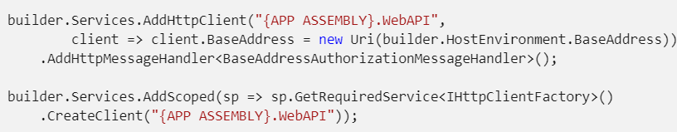
HttpClient configuration
In Program.Main (Program.cs), a named HttpClient ({APP ASSEMBLY}.WebAPI) is configured to supply HttpClient instances that include access tokens when making requests to the server API:
The placeholder {APP ASSEMBLY} is the app's assembly name (for example, BlazorSample.Client).

Slide 21

API authorization support
The support for authenticating users is plugged into the service container by the extension method provided inside the Microsoft.AspNetCore.Components.WebAssembly.Authentication package.
This method sets up the services required by the app to interact with the existing authorization system.

Slide 22
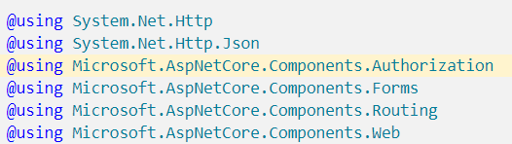
Imports file
The Microsoft.AspNetCore.Components.Authorization namespace is made available throughout the app via the _Imports.razor file:

Slide 23
Index page
The Index page (wwwroot/index.html) page includes a script that defines the AuthenticationService in JavaScript. AuthenticationService handles the low-level details of the OIDC protocol.
The app internally calls methods defined in the script to perform the authentication operations.

Slide 24
App component
The App component (App.razor) is similar to the App component found in Blazor Server apps:
The CascadingAuthenticationState component manages exposing the AuthenticationState to the rest of the app.
The AuthorizeRouteView component makes sure that the current user is authorized to access a given page or otherwise renders the RedirectToLogin component.
The RedirectToLogin component manages redirecting unauthorized users to the login page.

Slide 25
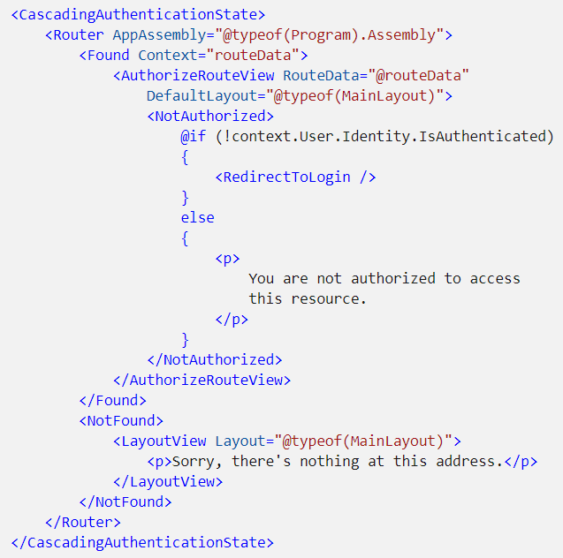
App component

Slide 26
RedirectToLogin component
The RedirectToLogin component (Shared/RedirectToLogin.razor):
Manages redirecting unauthorized users to the login page.
Preserves the current URL that the user is attempting to access so that they can be returned to that page if authentication is successful.

Slide 27
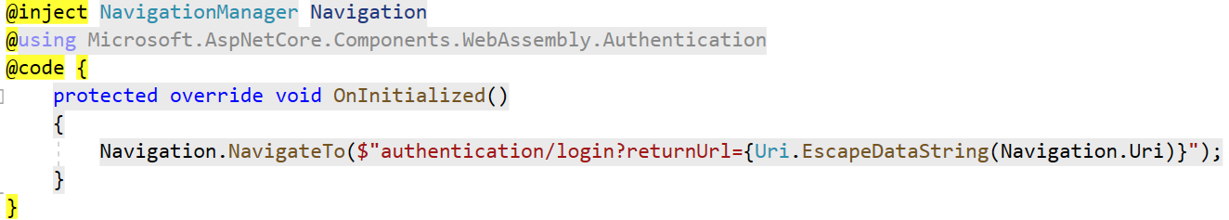
RedirectToLogin component

Slide 28
LoginDisplay component
The LoginDisplay component (Shared/LoginDisplay.razor) is rendered in the MainLayout component (Shared/MainLayout.razor) and manages the following behaviors:
For authenticated users:
Displays the current user name.
Offers a link to the user profile page in ASP.NET Core Identity.
Offers a button to log out of the app.

Slide 29
LoginDisplay component
For anonymous users:
Offers the option to register.
Offers the option to log in.

Slide 30
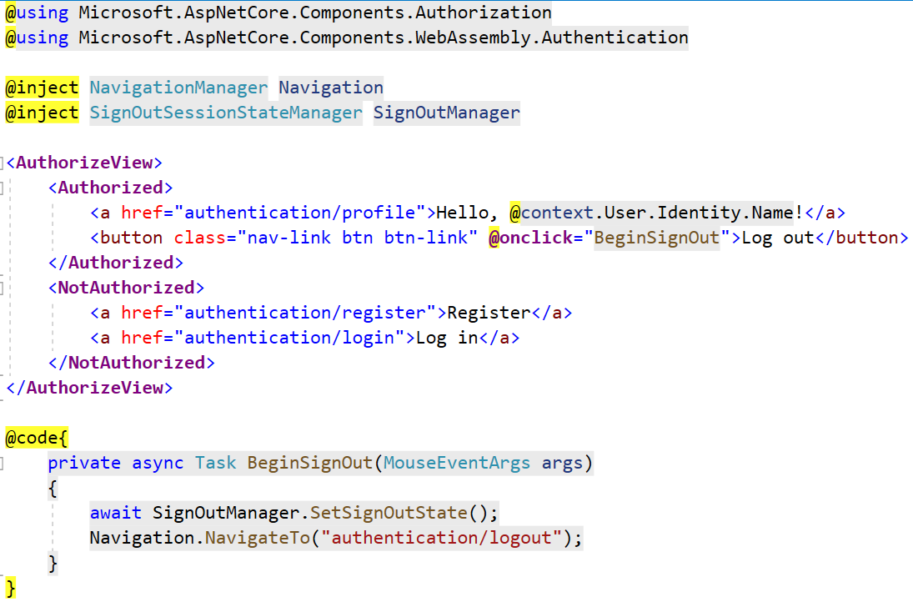
LoginDisplay component

Slide 31
Authentication component
The page produced by the Authentication component (Pages/Authentication.razor) defines the routes required for handling different authentication stages.
The RemoteAuthenticatorView component:
Is provided by the Microsoft.AspNetCore.Components.WebAssembly.Authentication package.
Manages performing the appropriate actions at each stage of authentication.

Slide 32
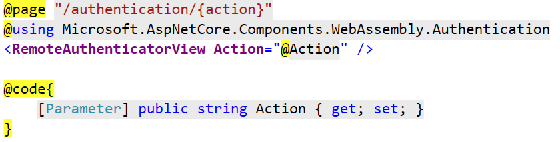
Authentication component

Slide 33
FetchData component
The FetchData component shows how to:
Provision an access token.
Use the access token to call a protected resource API in the Server app.
The @attribute [Authorize] directive indicates to the Blazor WebAssembly authorization system that the user must be authorized in order to visit this component.
The presence of the attribute in the Client app doesn't prevent the API on the server from being called without proper credentials. The Server app also must use [Authorize] on the appropriate endpoints to correctly protect them.

Slide 34
FetchData component
IAccessTokenProvider.RequestAccessToken takes care of requesting an access token that can be added to the request to call the API.
If the token is cached or the service is able to provision a new access token without user interaction, the token request succeeds. Otherwise, the token request fails with an AccessTokenNotAvailableException, which is caught in a try-catch statement.

Slide 35
FetchData component
In order to obtain the actual token to include in the request, the app must check that the request succeeded by calling tokenResult.TryGetToken(out var token).
If the request was successful, the token variable is populated with the access token. The AccessToken.Value property of the token exposes the literal string to include in the Authorization request header.

Slide 36
FetchData component
If the request failed because the token couldn't be provisioned without user interaction, the token result contains a redirect URL. Navigating to this URL takes the user to the login page and back to the current page after a successful authentication.

Slide 37
Client side – static variables
Example

Slide 38
Types of browser storage
Cookies.
Local storage.
Session storage.
IndexedDB.
Web SQL.
Cache storage.

Slide 39
Cookies
Can only store 4 KB of data — this limit will vary a little based on the browser implementation
The number of cookies allowed on a domain is restricted based on the browser implementation (e.g., 20)
The total number of cookies across domains is restricted (e.g., 300 ). The oldest cookie is removed once the limit has been reached in order to store the new cookie. The number is based on the browser implementation.

Slide 40
Web Storage API
Web Storage API allows web applications to store data locally within the user browsers. The APIs are enabled as part of the HTML5 standards.
Compared to cookies, the storage limit is larger — e.g., at least 5 MB (the actual size is based on the browser implementation). The information is client-side only and not shared to the server. The server won’t have any access to modify the data.E

Slide 41
Web Storage API
The data can’t be shared between domains, including subdomains. Each origin (protocol and domain combination) will have unique storage — all of the API operations are performed in the origin-specific storage.

Slide 42
localStorage
The localStorage object stores the data with no expiration date.
The data won’t be deleted when the browser is closed and will be available in the next day, week, or year — until deleted by the website or by the user.

Slide 43
sessionStorage
The sessionStorage object is equal to the localStorage object except it stores the data for only one session.
The data is deleted when the user closes the specific browser tab.

Slide 44
Web Storage API
The Web Storage API stores the data as key/value pairs. All of the data is stored as a string, while all of the data added into the storage implicitly is converted into a string.
It explicitly converts the data to the required type on retrieval. The JSON.parse() and JSON.stringify() methods can be used for serialization and deserialization of object data from/to storage.

Slide 45
Bibliography
https://docs.microsoft.com/en-us/aspnet/core/blazor/security/webassembly/hosted-with-identity-server?view=aspnetcore-5.0&tabs=visual-studio

